Slide 1
Reinforcement Learning
Machine Learning
Class 1, Week 2
Author: Galib Anwar
Credits: Daniel Johnson, Andre Violante, BARD, ChatGTP, Bing

Slide 2
What is Reinforcement Learning (RL) ?
RL is the exiting, new type of Machine Learning (ML) !
The third one, alongside Supervised and Unsupervised ML.
It’s a Machine Learning method that is concerned with how software agents should take actions in an environment. RL is a part of the deep learning that helps to maximize some portion of the cumulative reward.
This neural network learning method helps to learn how to attain a complex objective or maximize a specific dimension over many steps.

Slide 3
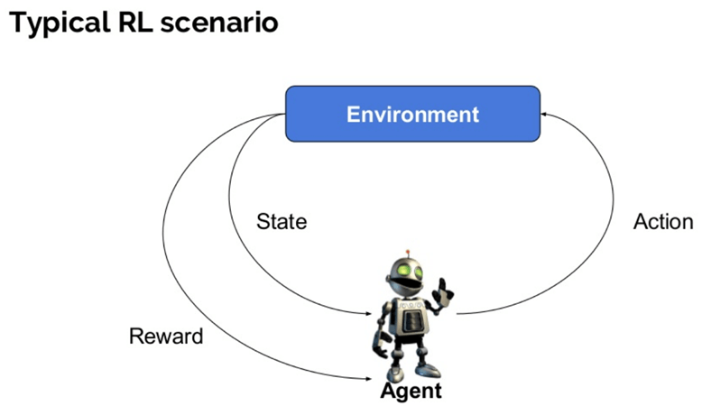

Slide 4
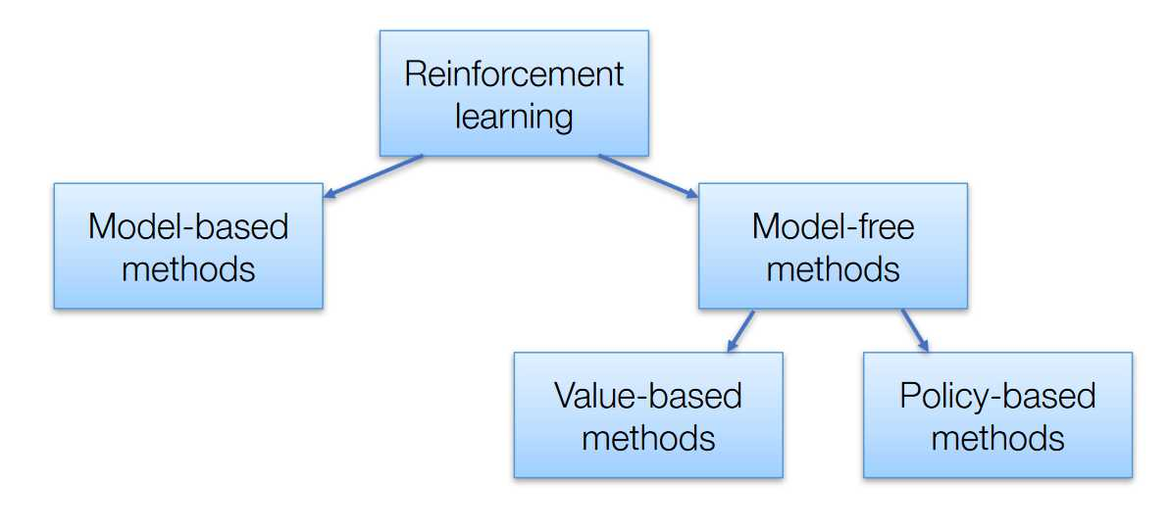
Algorithms of Reinforcement Learning

Slide 5
Categories continued…
Model-based:
These algorithms aim to learn how the environment works (its dynamics) from its observations and then plans a solution using that model. When they have a model, they use some planning method to find the best policy. They known to be data efficient, but they fail when the state space is too large.
Model-free:
Model-free algorithms do not require to learn the environment and store all the combination of states and actions. The can be divided into two categories, based on the ultimate goal of the training.
Policy-based methods try to find the optimal policy, whether it’s stochastic or deterministic. Algorithms like policy gradients and REINFORCE belong in this category. Their advantages are better convergence and effectiveness on high dimensional or continuous action spaces.
Policy-based methods are essentially an optimization problem, where we find the maximum of a policy function. That’s why we also use algorithms like evolution strategies and hill climbing.
Value-based methods, on the other hand, try to find the optimal value. A big part of this category is a family of algorithms called Q-learning, which learn to optimize the Q-Value. I plan to analyze Q-learning thoroughly on a next article because it is an essential aspect of Reinforcement learning. Other algorithms involve SARSA and value iteration.
At the intersection of policy and value-based method, we find the Actor-Critic methods, where the goal is to optimize both the policy and the value function.

Slide 6
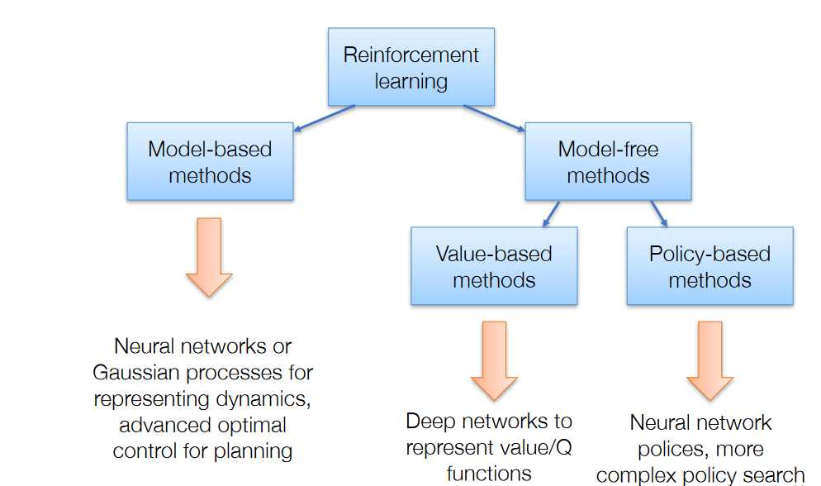
And the leap forward to Deep RL
Latest enhancement to RL has been through the incorporation of Deep Neural Networks.
Deep neural networks have been used to model the dynamics of the environment(mode-based), to enhance policy searches (policy-based) and to approximate the Value function (value-based). Research on the last one (which is my favorite) has produced a model called Deep Q Network, which is responsible ,along with its many improvements, for some of the most astonishing breakthroughs around the area (take Atari for example). And to excite you, even more, we don’t just use simple Neural Networks but Convolutional, Recurrent and many else as well.

Slide 7
Core Concepts & Terminologies
Agent: It is an assumed entity which performs actions in an environment to gain some reward.
Environment (e): A scenario that an agent has to face.
Reward (R): An immediate return given to an agent when he or she performs specific action or task.
State (s): State refers to the current situation returned by the environment.
Policy (π): It is a strategy which applies by the agent to decide the next action based on the current state.
Value (V): It is expected long-term return with discount, as compared to the short-term reward.
Value Function: It specifies the value of a state that is the total amount of reward. It is an agent which should be expected beginning from that state.
Model of the environment: This mimics the behavior of the environment. It helps you to make inferences to be made and also determine how the environment will behave.
Model based methods: It is a method for solving reinforcement learning problems which use model-based methods.
Q value or action value (Q): Q value is quite similar to value. The only difference between the two is that it takes an additional parameter as a current action.
Exploitation vs Exploration : next action strategy – exploit/employ current experience in Q-Table or explore random new action
Training Episode: An episode starts with the agent in an initial state and ends when it reaches the goal state or a maximum number of steps is reached.
Discount: is a parameter that determines how much the agent values future rewards compared to immediate rewards.

Slide 8
Core concepts extended…
Episode: A sequence of states, actions, and rewards that ends when the agent reaches a terminal state or a predefined time limit.
Horizon: The maximum number of steps or actions that the agent can take in an episode.
Markov property: The assumption that the next state and reward depend only on the current state and action, and not on the previous history.
Markov decision process (MDP): A mathematical framework for modeling reinforcement AI problems that satisfy the Markov property. It consists of a set of states, a set of actions, a transition function, and a reward function.
Partially observable Markov decision process (POMDP): A generalization of MDPs that accounts for the agent's partial or noisy observation of the environment state. It consists of a set of states, a set of actions, a transition function, a reward function, and an observation function.
Bellman equation: An equation that relates the value function of a state or an action to the expected value function of the next state or action. It forms the basis for many reinforcement AI algorithms.
Monte Carlo method: A reinforcement AI method that estimates the value function by averaging the returns from multiple episodes or trajectories.
Temporal difference method: A reinforcement AI method that updates the value function by bootstrapping from the current estimate and the observed reward and next state.
Q-learning: A model-free temporal difference algorithm that learns an optimal action-value function by using the maximum value for the next state.
SARSA: A model-free temporal difference algorithm that learns an action-value function by using the actual action taken for the next state.
Policy iteration: A model-based reinforcement AI algorithm that alternates between policy evaluation and policy improvement until convergence to an optimal policy and value function.
Value iteration: A model-based reinforcement AI algorithm that combines policy evaluation and policy improvement into a single step until convergence to an optimal policy and value function.
Actor-critic method: A reinforcement AI method that uses two neural networks: an actor that learns a policy and a critic that learns a value function. The critic provides feedback to the actor to improve its policy.
Policy gradient method: A reinforcement AI method that directly optimizes a parameterized policy by following the gradient of the expected return with respect to the policy parameters.
Deep Q-Network (DQN): A deep reinforcement AI algorithm that uses a deep neural network to approximate the Q-value function and incorporates experience replay and target networks to stabilize the learning process.

Slide 9
Characteristics of Reinforcement Learning
Some important characteristics of reinforcement learning are,
There is no supervisor, only a real number or reward signal
Sequential decision making
Time plays a crucial role in Reinforcement problems
Feedback is always delayed, not instantaneous
Agent’s actions determine the subsequent data it receives

Slide 10
Types of Reinforcement Learning
There are two types of reinforcement learning methods:
Positive:
It is defined as an event, that occurs because of specific behavior. It increases the strength and the frequency of the behavior and impacts positively on the action taken by the agent.
This type of Reinforcement helps you to maximize performance and sustain change for a more extended period. However, too much Reinforcement may lead to over-optimization of state, which can affect the results.
Negative:
Negative Reinforcement is defined as strengthening of behavior that occurs because of a negative condition which should have stopped or avoided. It helps you to define the minimum stand of performance. However, the drawback of this method is that it provides enough to meet up the minimum behavior.

Slide 11
Learning Models of Reinforcement There are two important learning models in reinforcement learning:
Markov Decision Process
Q-Learning
The following parameters are used to get a solution:
Set of actions- A
Set of states -S
Reward- R
Policy- n
Value- V
Q learning is a value-based method of supplying information to inform which action an agent should take.

Slide 12
Applications of Reinforcement Learning
Here are some areas of application of Reinforcement Learning:
Robotics for industrial automation.
Business strategy planning
Machine learning and data processing
It helps you to create training systems that provide custom instruction and materials according to the requirement of students.
Aircraft control and robot motion control

Slide 13
Why use Reinforcement Learning?
Here are some of the prime reasons for using Reinforcement Learning:
It helps finding which situation needs an action
It helps to discover which action yields the highest reward over the longer period.
It provides the learning agent with a reward function.
It helps figuring out the best method for obtaining large rewards.

Slide 14
When Not to Use Reinforcement Learning?
You can’t apply reinforcement learning model is all the situation. Here are some conditions when you should not use reinforcement learning model.
When you have enough data to solve the problem with a supervised learning method
You need to remember that Reinforcement Learning is computing-heavy and time-consuming. in particular when the action space is large.

Slide 15
Challenges of Reinforcement Learning
Here are some of the major challenges you will face while doing Reinforcement Learning:
Feature/reward design which should be very involved
Parameters may affect the speed of learning.
Realistic environments can have partial observability.
Too much Reinforcement may lead to an overload of states which can diminish the results.
Realistic environments can be non-stationary.

